Slide 1
Accelerating Carbon
Capture using Oxyfuel
Technology in Cement
Production
ACT Knowledge Sharing Workshop
Dipl.- Ing. Jörg Maier
17.11.2020, Stuttgart

Slide 2
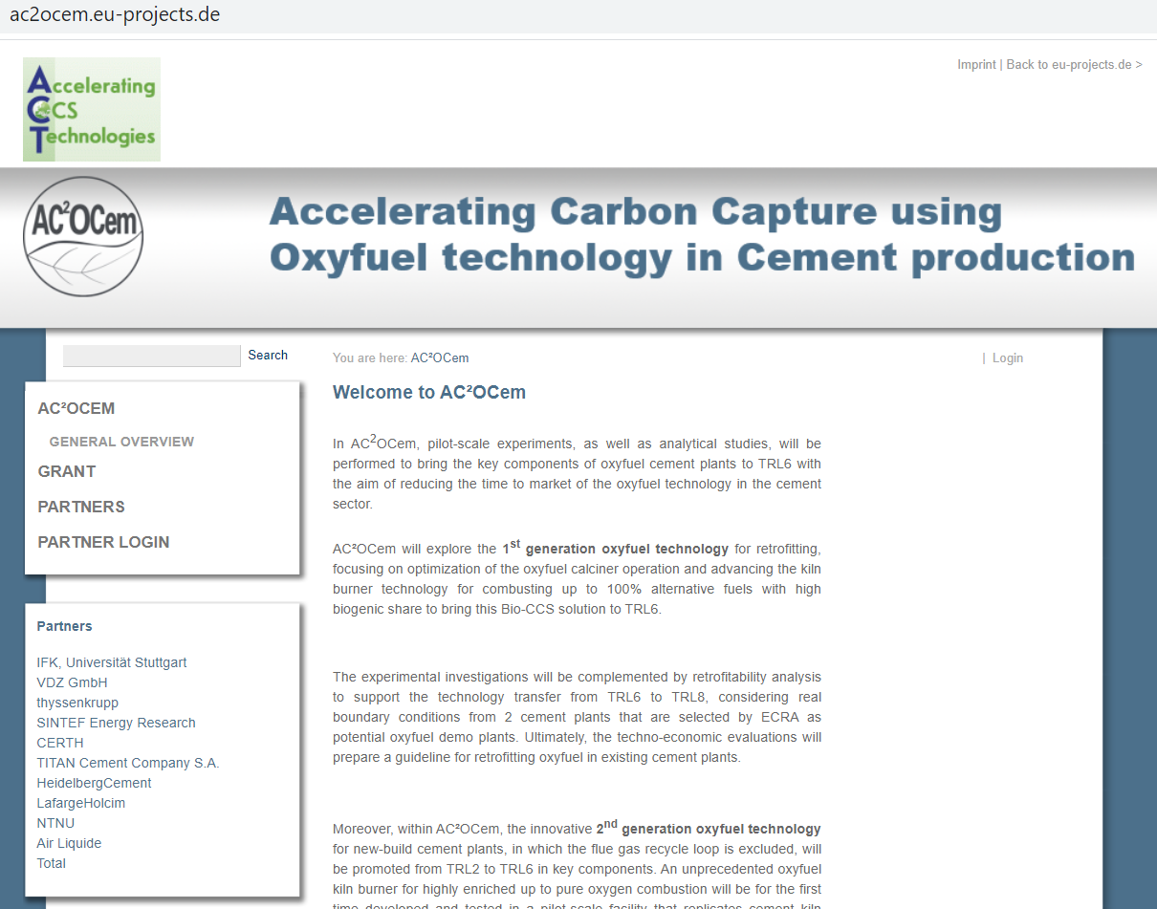
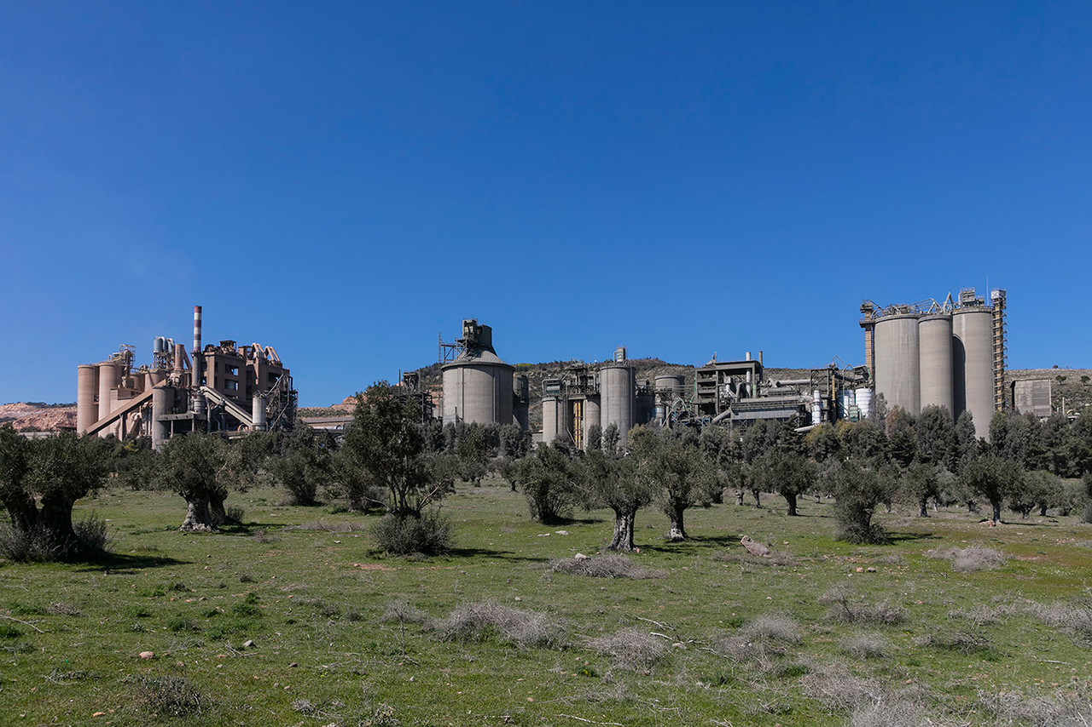
Introduction to AC²OCem
Summary
Project Duration 36 months
Start 1.10.2019
ACT Project No. 299663
ACT funding € 3.042.274
Total funding € 4.273.911
http://ac2ocem.eu-projects.de/
https://www.titan.gr/en/newsroom/media-library/photos

Slide 3
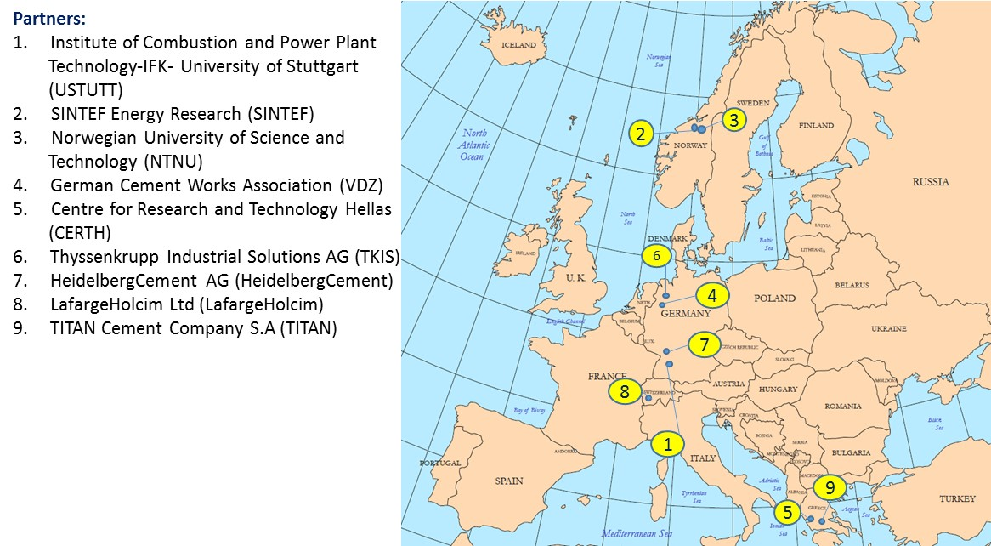

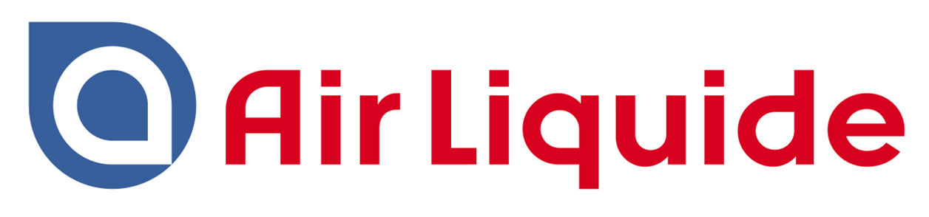









AC²OCem Consortium
11 Project Partners from 5 European Countries
Universität Stuttgart, Germany
SINTEF Energy Research, Norway
Norwegian University of Science and Technology NTNU, Norway
VDZ GmbH, Germany
Center of Research and Technology CERTH, Greece
thyssenkrupp Industrial Solutions AG, Germany
HeidelbergCement AG, Germany
LafargeHolcim, Switzerland
TITAN Cement Company S.A, Greece
Air Liquide, France
Total Norge AS, Norway
11
10

Slide 4
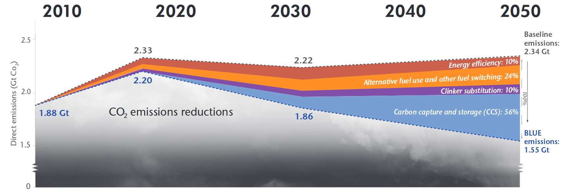
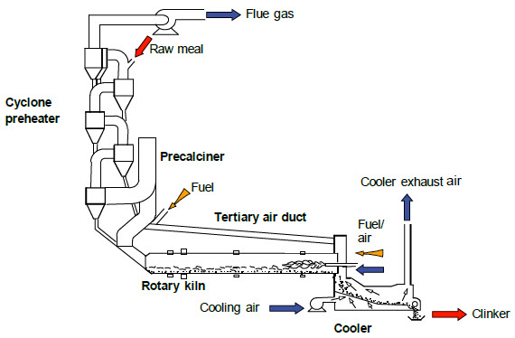
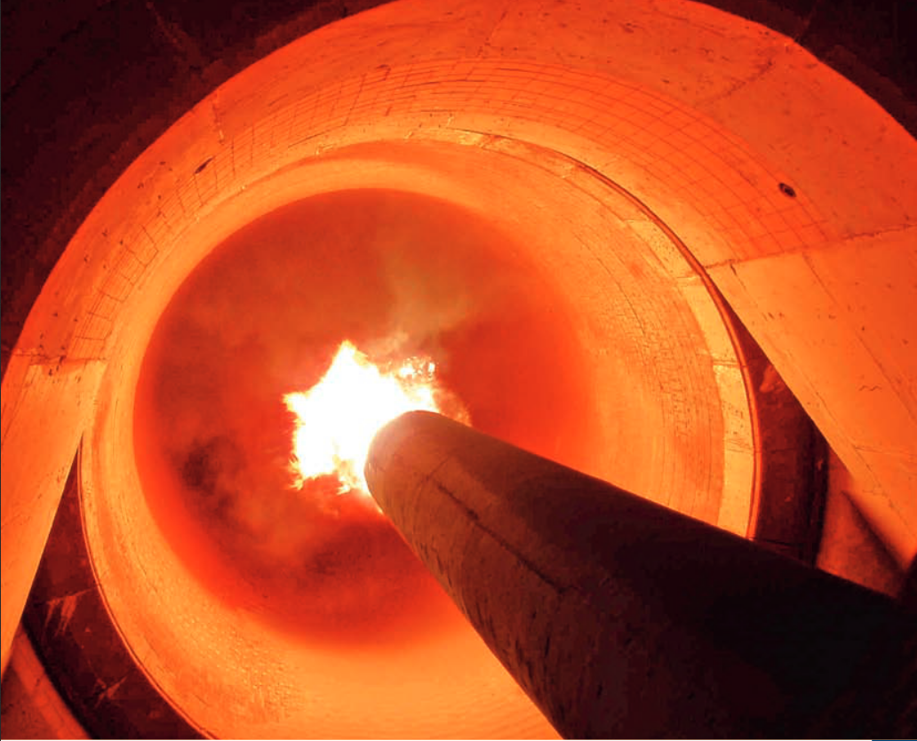
Motivation
50% of CO₂ => decomposition of limestone
Source: Cement Roadmap, IEA
1 ton of cement → 0,6 - 0,7 tons of CO₂
Source: International Energy Agency
Notes:
Part of cemcap project, specific task of evaluation of a downscaled burner

Slide 5
AC²OCem Project Objectives
Optimization of the oxyfuel cement process with the ultimate goal of lowering the CO₂ avoidance cost
Advancing the 1st & 2nd generation oxyfuel technology for utilization of up to 100% alternative fuels and up to 100 % oxygen, respectively, boosting CO₂ negative cement plants (Bio-CCS).
Techno-economic analysis and design optimization of two 1st generation cement plants, LafargeHolcim in Lägerdorf, Germany and HeidelbergCement in Slite, Sweden.
Experimental and analytical investigations of the 2nd generation oxyfuel technology without flue gas recycle, associated with a high reduction potential of energy demand, CAPEX and OPEX

Slide 6
AC²OCem work package structure
Notes:
In general, the work is divided into the following main activities:
Project management with focus on establishing clear management and results exploitation strategies.
Experimental investigations of oxyfuel burner technology for 1st and 2nd generation oxyfuel cement plants.
Experimental investigations of oxyfuel calciner.
Process simulations and techno-economic evaluations of the 1st generation oxyfuel technology for retrofitted cement plants.
Process simulations and techno-economic evaluation of the 2nd generation oxyfuel technology for new-build cement plants.
Life cycle assessment of oxyfuel technology for 1st and 2nd generation oxy-fuel cement plants.
Exploitation and dissemination of project results.

Slide 7
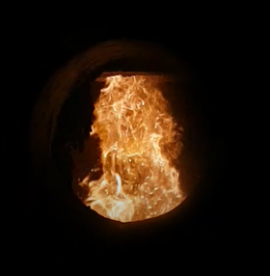
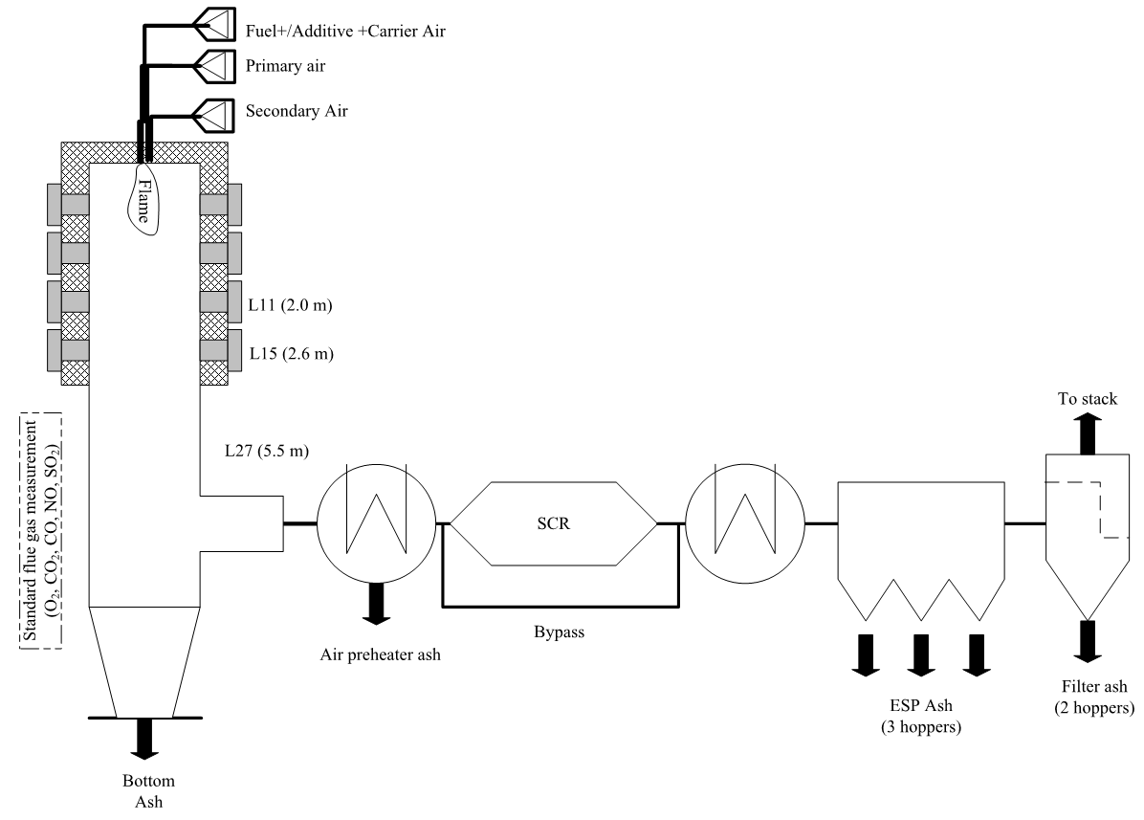
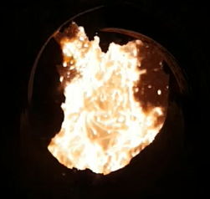
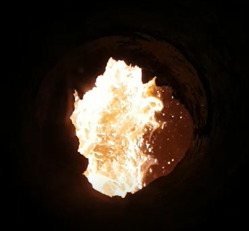
Combustion tests with 100 % SRF at USTUTT
Task 2.1
Planned operational conditions
L2
L3
L4
100 % SRF | 100 % SRF | 100 % SRF | 100 % SRF
Air | OXY 27 | OXY 33 | OXY 41
300 kW | 300 kW | 300 kW | 300 kW
λ = 1.15 | λ = 1.15 | λ = 1.15 | λ = 1.15
Next step: experimental campaign with 100% SRF at USTUTT
→ results will be used to validate the CFD simulation models of the combustion by CERTH/ SINTEF
500 kW combustion facility at USTUTT

Slide 8
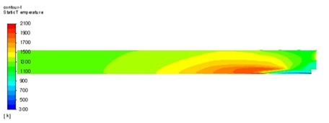
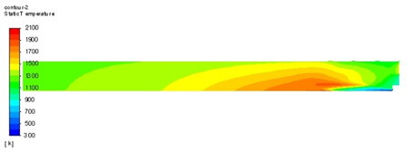
CFD preliminary work by SINTEF and CERTH
Included an UDF (WSGGM) for computing the absorbtion coefficients to the model used in CEMCAP (Stuttgart furnace). A line by line based weighted sum of gray gas model for inhomogeneous CO2-H2O mixture in oxy-fired combustion
Checked the dependency of grid. Total number of cells varied from 223k to 2599k
Inlets changed from mass flow to velocity inlets
Next step: Modelling of the pilot plant with pure O2 on the current burner dimension
Temperature fields
Without WSGGM
With WSGGM

Slide 9
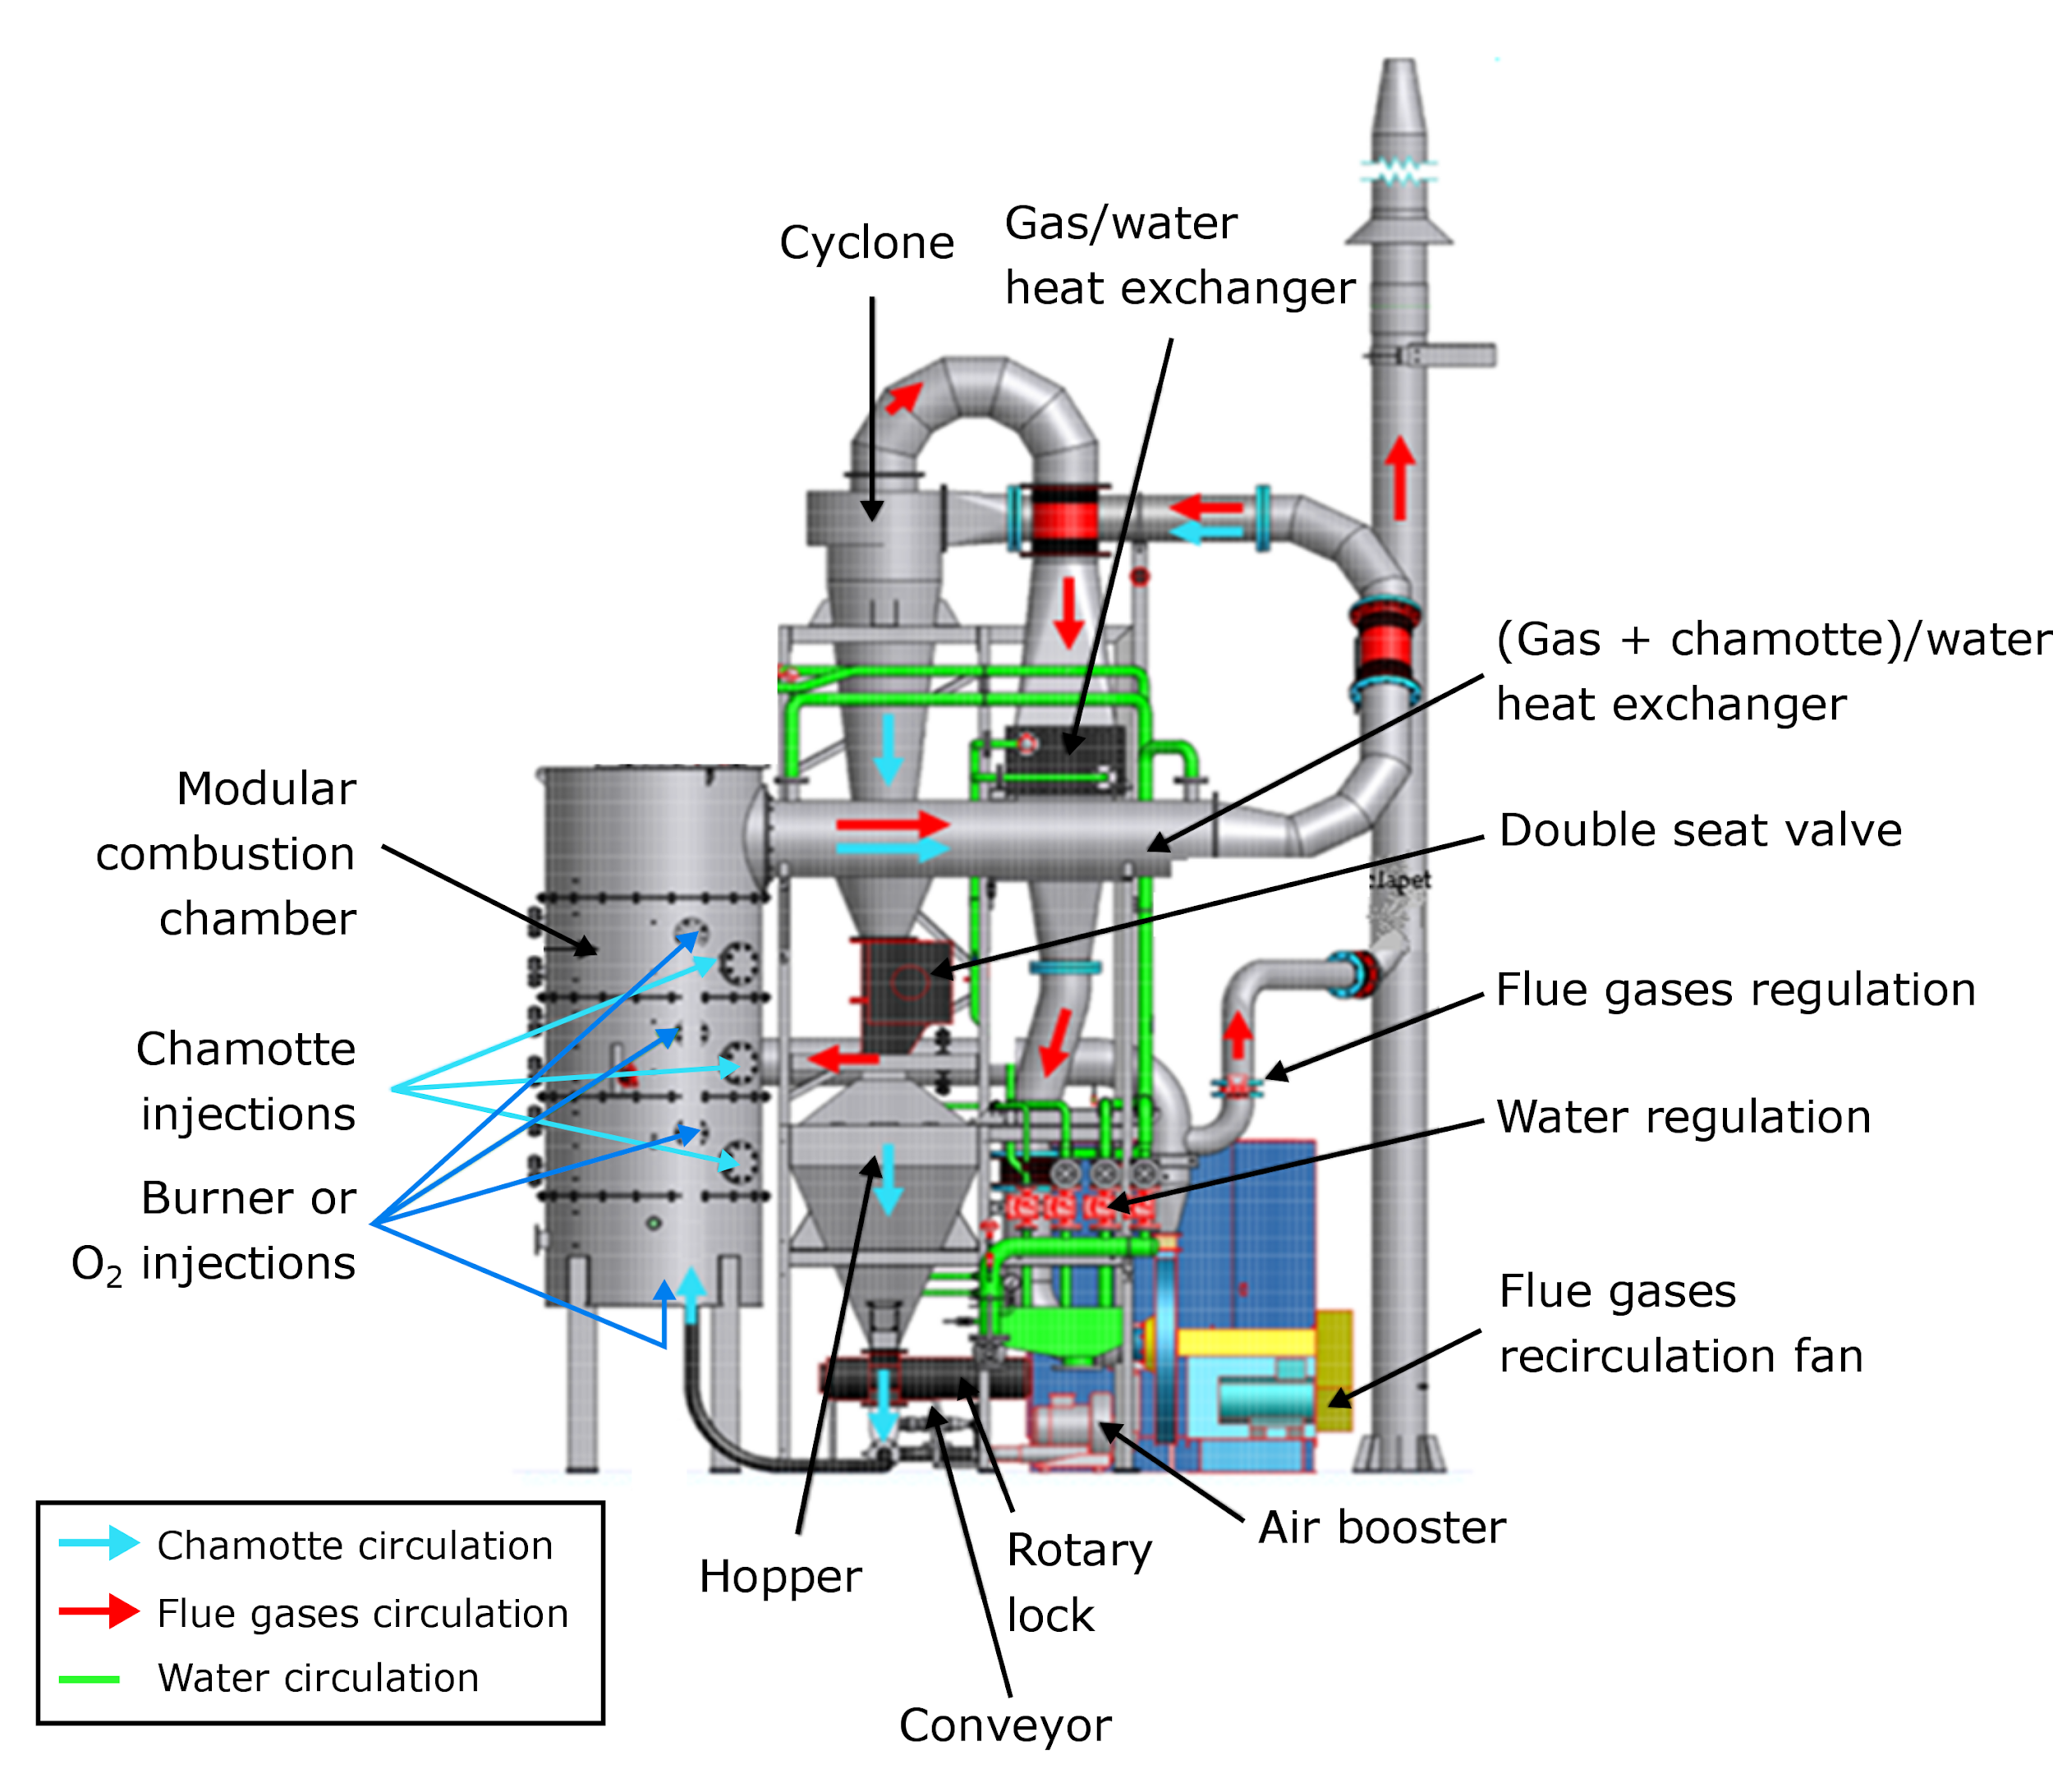
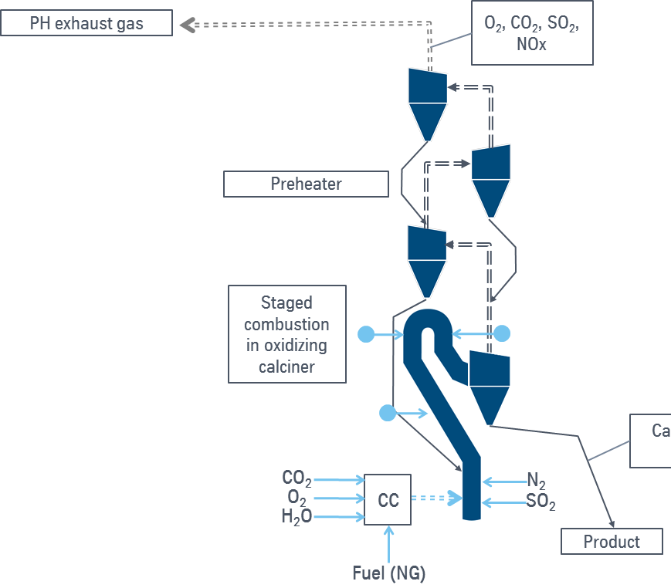
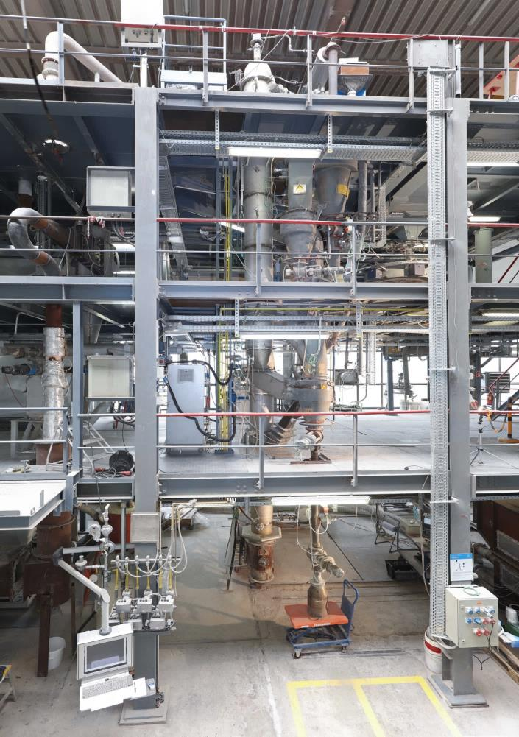
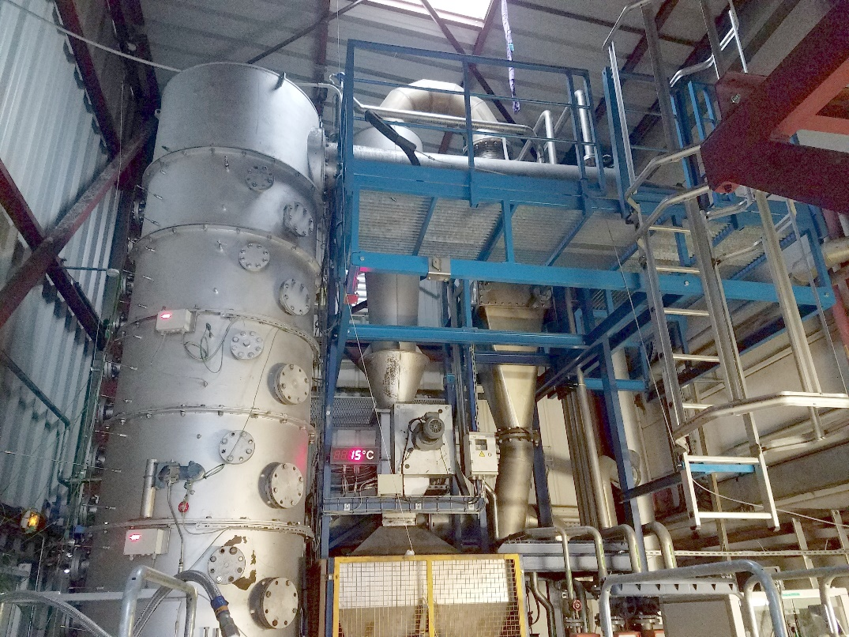
WP 3 Calcination tests under Oxyfuel Conditions
Laboratory calcination Test in USTUTT started and ongoing
Next step:
AL will start the pilot scale experimental testing in the 1 MW calciner with 100% alternative fuel in the calciner in December
TKIS will start pilot scale experimental testing in oxyfuel conditions in the calciner in Janury 2021
Calciner test furnace of AL
Pilot-scale calciner and 4 stage pre-heater - tkIS
Notes:
Raw meal dosage system : 0,2 to 2 kg/h
Gas supply system : mixture N₂, CO₂, Air
Electrically heated 5 Temperature zones T1-T5
Lance with thermocouples: T_{0,5} T_{1,0} T_{1,5} T_{2,0} T_{2,5} ,
corresponding to distance from injection point
Probe sampling for solid analysis via sampling unit
Sampling of reaction product using vertically shifted probe
Gas analyzer, placed after heated filter

Slide 10
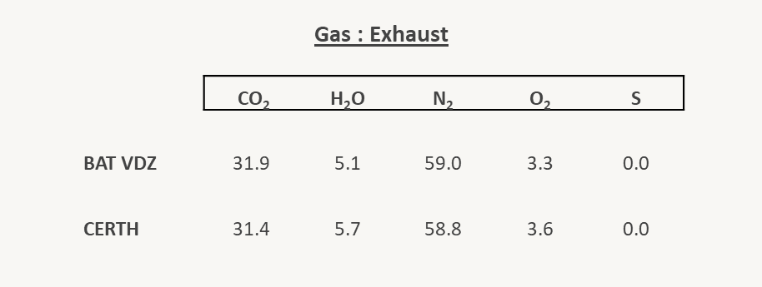


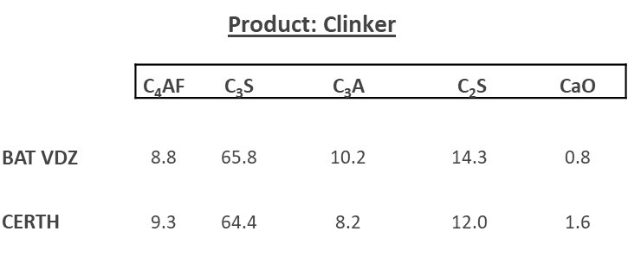
Integration of oxyfuel technology in existing cement plants (1. Generation)
  Work package 4
  (VDZ, CERTH, SINTEF, HeidelbergCement, LafargeHolcim, TITAN, TKIS, TOTAL, AL)
Design considerations for retrofitted oxyfuel cement plants (with reference to the BAT)
Process modelling and simulation of oxyfuel retrofitted cement plants considering several scenarios for flue gas recirculation
Results of task 4.1
A steady-state process model has been setup in ASPEN PLUS based on design and operating data of a reference 3000 t/d BAT plant.
The simulation is aligned with VDZ’s BAT model [1] to ensure consistency.
→ Good agreement of numerical results with the reference values.
Results Comparison (task 4.1)
[1] CEMCAP, D4.1 “Design and performance of CEMCAP cement plant without CO2 capture” https://www.sintef.no/globalassets/sintef-energi/cemcap/d4.1-cemcap-cement-plant-without-co2-capture_rev2.pdf/

Slide 11
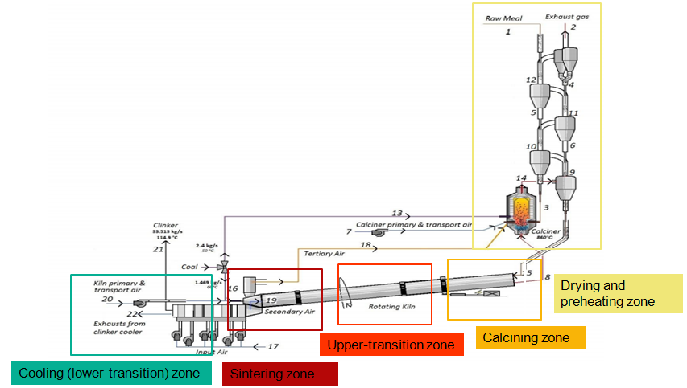
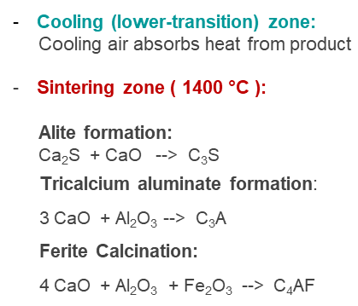
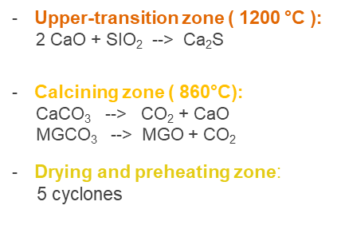
Integration of retrofit oxyfuel cement plants
Work package 4
Next step:
VDZ/CERTH Simulation based on boundary conditions provided by Industrial Partner to assess oxyfuel scenarios and create a separate model for simulating the CO₂ processing unit (CPU).
Investigate various oxyfuel scenarios.
Assessment of flue gas impurities and waste process streams in CPU operation

Slide 12




Summary WP 5/6
Oxyfuel 2nd genenation process scheme
Objectives
Exhaust gas PH
Optimization of the design and infrastructure for new-build plants.
Evaluation of techno-economic feasibility of new-build oxyfuel cement plants.
Next step: activity in WP 5 has begun for the preliminary design considerations of oxyfuel operation
Raw meal to PH
Calciner
Fuel transport gas, burner gas
fuel
Cooler exhaust gas
fuel
Kiln
ASU
clinker
storage
O₂ = 99.5 %
N₂ = 0.5 %
air
WP6 LCA Next step: WP 6 starts in June 2021, NTNU is already busy with literature study and pre-organization of information for the environmental impact and life cycle analysis
Cooler

Slide 13
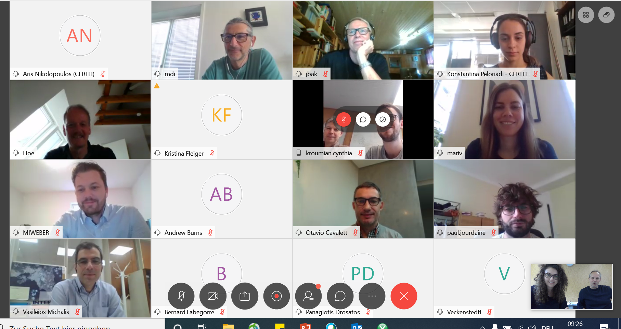
Next steps
Staying in contact during the pandemic
… what our meetings look like today
Unfortunately, the pandemic happened in a time frame heavy with experimental activities → some experiments are postponed due to safety measures
The consortium partners are working together to abate any further delays by starting simulation tasks earlier than planned
this helps keep the project on track and insures CCS research is accelerate!
Next progress meeting in January 27 & 28, 2021
Excellent Project Team
Notes:
Next progress meeting in January

Slide 14



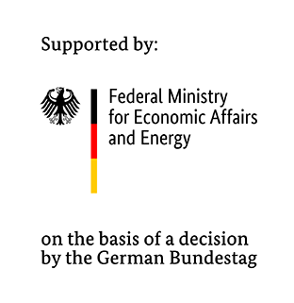
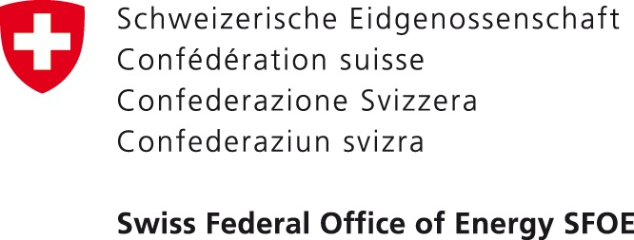



Thank you to our funding agencies
          AC²OCem is funded through the ACT program (Accelerating CCS Technologies, Horizon2020 Project No 299663).
Financial contributions, from the following agencies, are gratefully acknowledged
Research Council of Norway, (RCN), Norway
Federal Ministry for Economic Affairs and Energy (BMWi), Germany
Swiss Federal Office of Energy (SFOE), Switzerland
General Secretariat for Research and Development (GSRT), Greece
French Environment & Energy Management Agency (ADEME), France

Slide 15
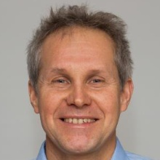
Dipl.-Ing. Jörg Maier
joerg.maier@ifk.uni-stuttgart.de
63396
63491

Slide 16
Progress of AC²OCem
✓ ✓ ✓ ✓
✓ ✓
✓ ✓
✓ ✓ ✓ ✓
✓ ✓

Slide 17
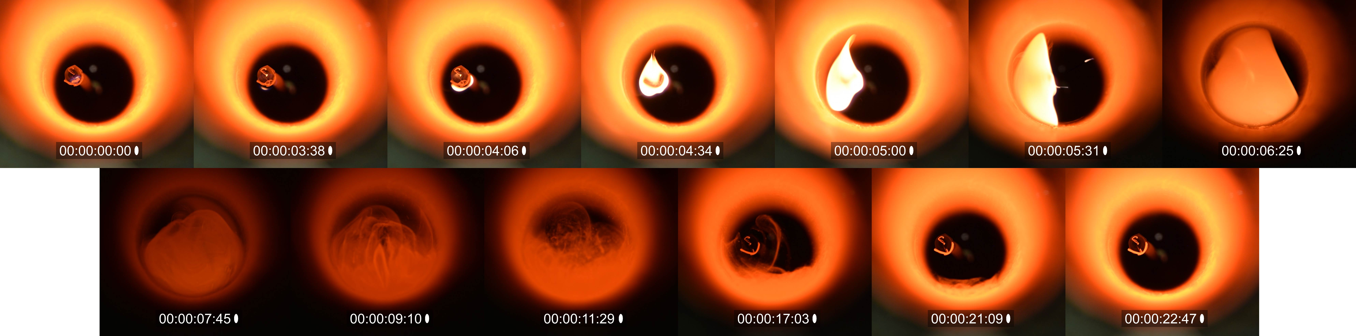
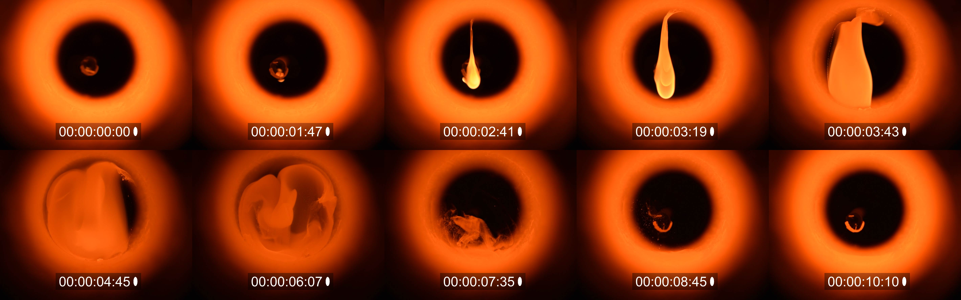
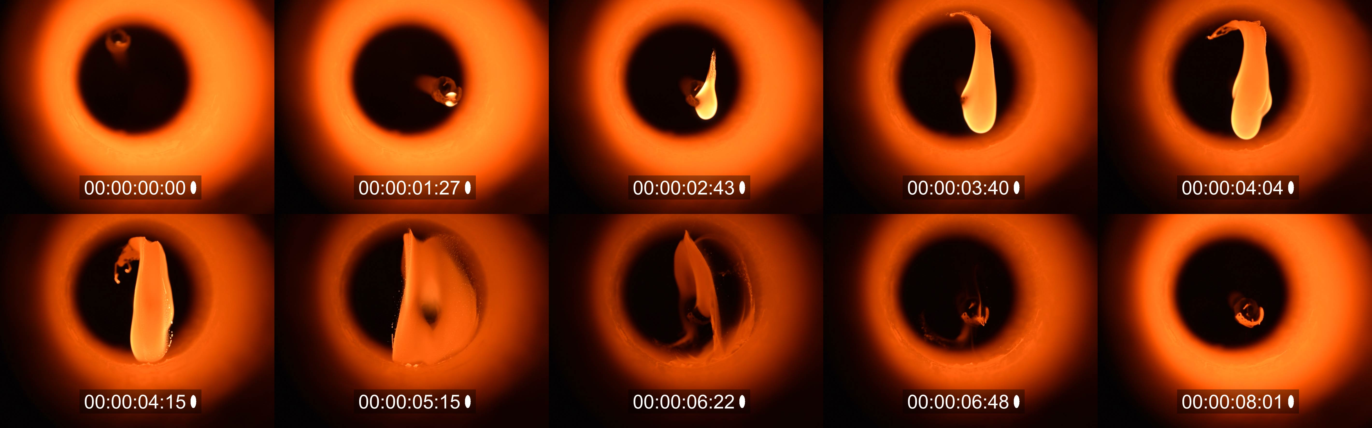
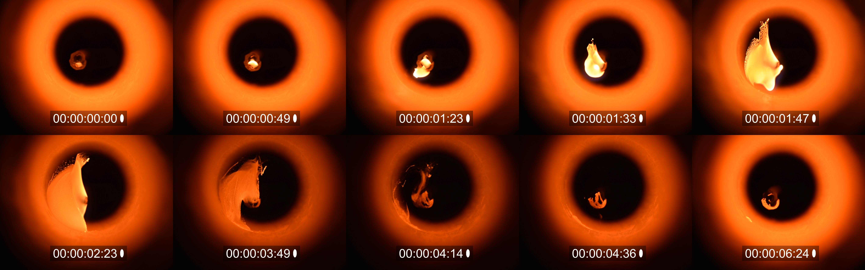
Single particle combustion tests with HDPE in Oxyfuel
Task 2.1
Air (Luft)
b
O₂ content
OXY30
Temp.
a
c
d
OXY50
OXY75
Size [mm] | Temp [°C] | Case
8 | 1000 | Air (Luft)
 | 1200 | OXY30
 |  | OXY50
 |  | OXY75
Notes:
allg. Verlauf:
Zündung auf der oberen Fläche → Schmelzen → Zündung auf der unteren Fläche → Flamme wächst mit der Tröpfchenbildung → Flamme expandiert (Gas) → Koks (ab Oxy50) → Koks Abbrand

