Slide 1
WP2: Advanced oxyfuel burner technologies
Mid-term review meeting
29 June 2021
Cynthia Kroumian, USTUTT

Slide 2
Objectives
Pilot-scale experiments with up to 100 % alternative fuels, (e.g. SRF), in an optimized oxyfuel kiln burner to show 1st generation oxyfuel with high oxygen enrichment to bring the technology to TRL 6
Pilot-scale developing and testing of an advanced burner to evaluate the innovative 2nd generation oxyfuel combustion technology with up to 100 % O₂ combustion and without flue gas recycle while maintaining relevant process parameters to promote this technology to TRL 6
Adaptation and validation of CFD combustion models for high shares of alternative fuel combustion in an O₂ enriched environment, while maintaining clinker production parameters

Slide 3
WP2 Team
Joerg Maier (USTUTT)
Cynthia Kroumian (USTUTT)
Ines Veckenstedt (TKIS)
(AL)
Mario Ditaranto (SINTEF)
Mari Voldsund (SINTEF)
Dimitrios Fakis (CERTH)
+ Ilia Shesterikov (USTUTT)
Adolf Neuwirth (USTUTT)
Panagiotis Drosatos (CERTH)
Vasileios Michalis (TITAN)
Andrew Burns (HC)
Mirko Weber (LH)
USTUTT | Demonstration tests of the 1st and 2nd generation oxyfuel burner
TKIS | Support in burner optimization
TITAN, HeidelbergCement & LafargeHolcim | Deliver fuels of interest and provide know-how
CERTH | 1st generation CFD simulations
SINTEF | 2nd generation CFD simulations
AL | Support in design of 2nd generation burner

Slide 4
Highlights
Pilot-scale experiments in the 500 kW facility at USTUTT with 100 % SRF and different combustion gas compositions
CERTH has developed the geometric model and numerical mesh for the 1st generation scenario
SINTEF has:
CFD model set up (grid, oxy adapted kinetic and radiation, turbulence models, etc.) of the USTUTT pilot facility ready (except 2nd generation burner which design is not finalized yet).
A model for the clinker chemistry, heat and mass transfer inside the CFD model of the full scale cement rotary kiln has been developed and tested.

Slide 5
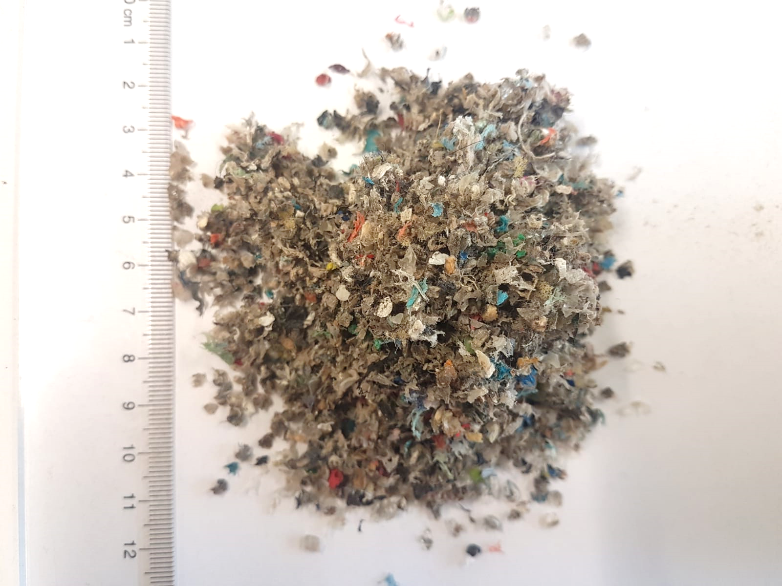
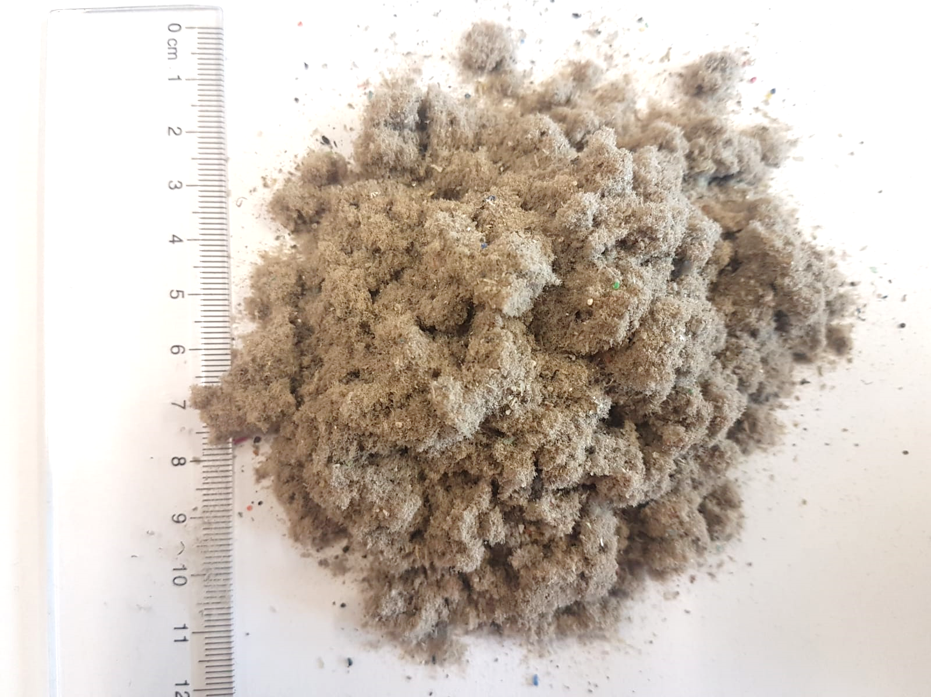
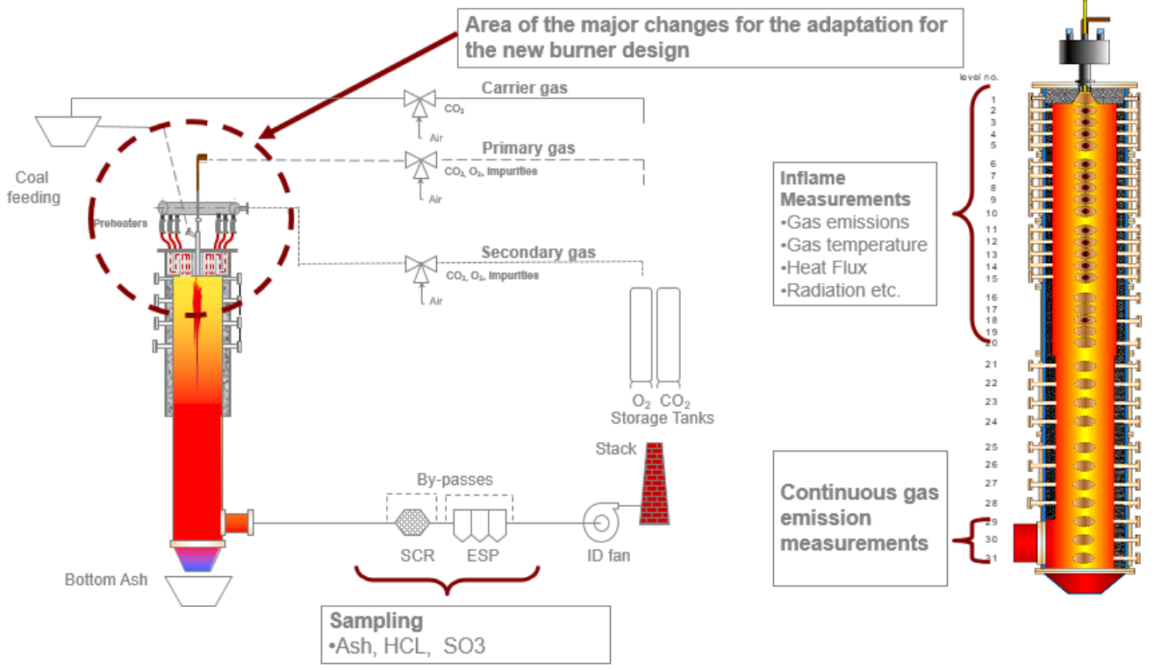
Highlights
Task 2.1
 | Unit | Coal-Air | SRF-Air | SRF-OXY31 | SRF-AIR28
Fuel
Thermal input | kW | 304 | 331 | 328 | 324
Mass flow rate | kg/h | 42 | 48 | 47.6 | 47
Primary Gas
Volume flow rate | Nm³/h | 46 | 43.5 | 51 | 25 Nm³Air/h 24 Nm³O₂/h
Temperature | °C | 28 | 28 | 28 | 28
Composition | Vol.-% | Air | Air | 70.6 %O₂ 29.4 %CO₂ | 60 %O₂
Secondary Gas
Volume flow rate | Nm³/h | 270 | 257 | 167 | 175
Temperature | °C | 600 | 600 | 600 | 600
Composition | Vol.-% | Air | Air | 22.2 %O₂ 77.8 %CO₂ | Air
Carrier Gas
Volume flow rate | Nm³/h | 28 | 28.4 | 22 | 30.5
Temperature | °C | 28 | 28 | 28 | 28
Composition | Vol.-% | Air | Air | CO₂ | Air
Flame detector
Volume flow rate | Nm³/h | 10 | 10 | 10 | 10
Temperature | °C | 30 | 30 | 30 | 30
Composition | Vol.-% | Air | Air | Air | Air
Air-fuel equivalence ratio
λ | - | 1.2 | 1.15 | 1.15 | 1.15
SRF <6mm
SRF 1 mm
SRF/biofuel
feeding

Slide 6
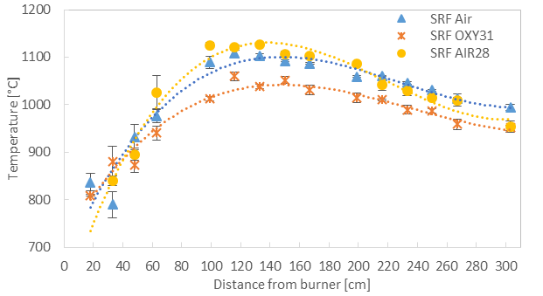
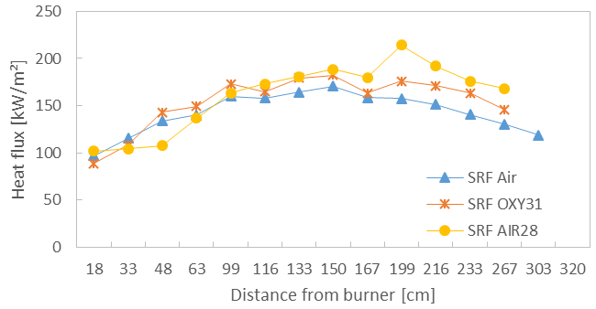
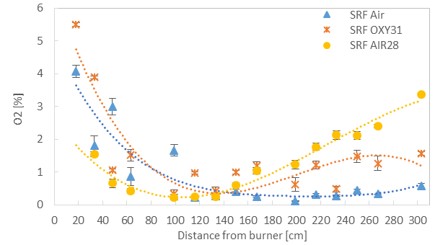
Highlights
Task 2.1

Slide 7
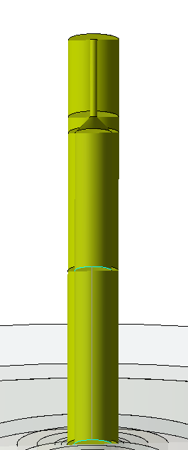
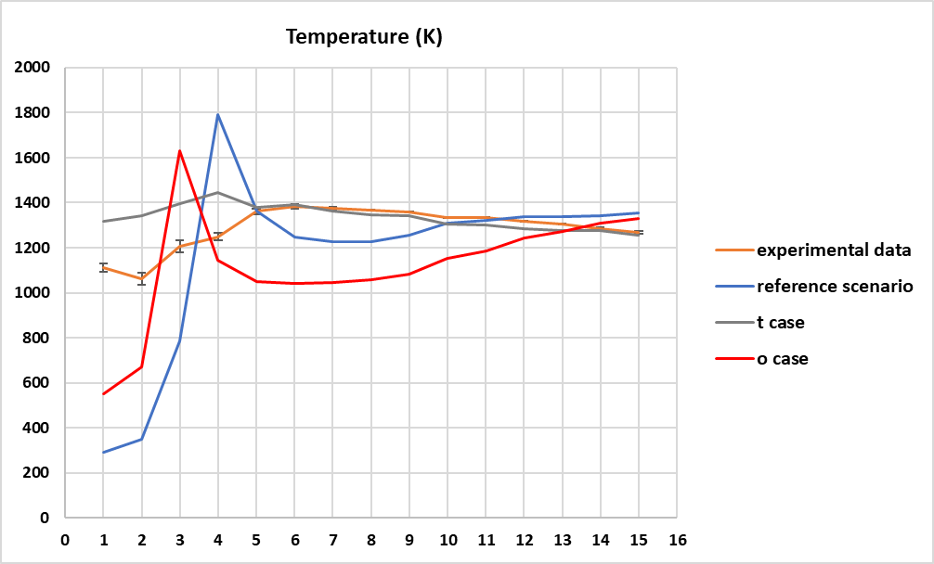
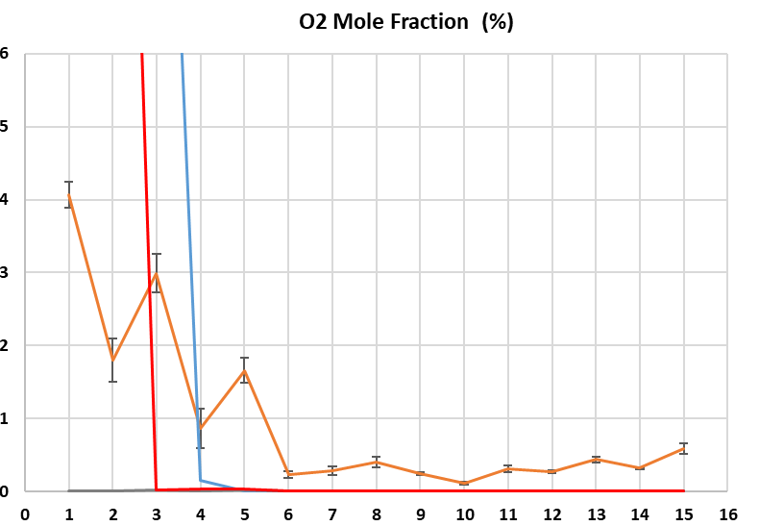
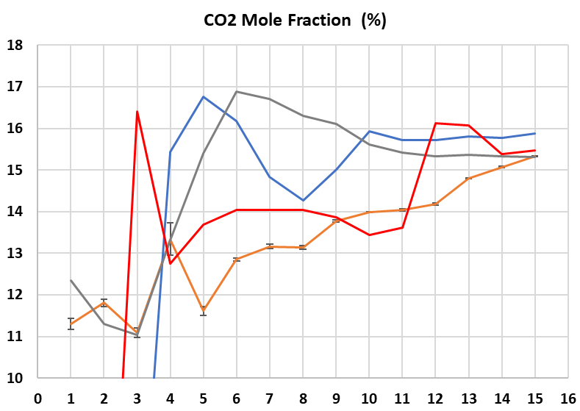
Highlights
Task 2.2
Geometric model
Numerical grid
Case | Inlet stream temp [K] | Pre-heated primary and carrier streams
Reference | 301 | NO
t case | 873 | YES
o case | 600 | YES
All dimensions in mm
34.3
Ø5
53.5
11
Ø25
Burner
95.5
120
280
Notes:
The geometry of the first generation oxyfuel burner has been modelled in detail and incorporated into the previously developed geometric model (presented in the last meeting)
Bluff body formation has been taken into account
Primary drall: inlet for primary air
According to the provided information, the flow of the primary air will be clockwise (as seen from the top) with 55º swirl angle
Then, the required numerical grid has been developed with approximately 0.6M elements and acceptable quality.
At the first measurement points, the calculated temperature and CO₂ mole fraction (in dry conditions) values are lower, while the O₂ mole fraction (in dry conditions) values are higher than reference values → not so intense combustion in CFD simulation
The CFD temperature distribution is in good agreement with experimental data (except for the first points)
The O₂, CO₂ distributions need to be improved
Absolute difference at the last point (well-developed flow field) for O₂,CO₂ between measurements and CFD results ~0.5%
As the primary and carrier streams are obtaining the highest temperature values examined due to pre-heating (case “t”), the overall temperature distribution is coming really close to the experimental data
The derived CFD results as regards the CO₂ mole fraction (in dry conditions) in the last measurement point is in full agreement with experimental values in the case “t”
The case “t” shows better agreement with experimental data as regards CO₂ mole fraction (in dry conditions) in the first four measurement points
The derived CFD results as regards the O₂ mole fraction (in dry conditions) in the last measurement point show no difference among the cases, while in the case “t” the oxygen distribution along the centerline presents zero values (intense combustion)

Slide 8
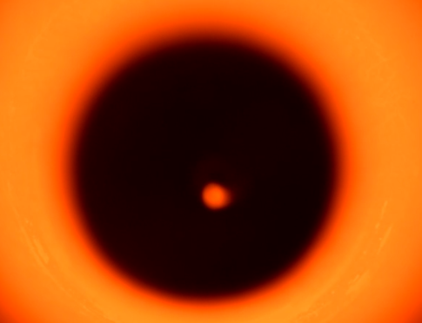
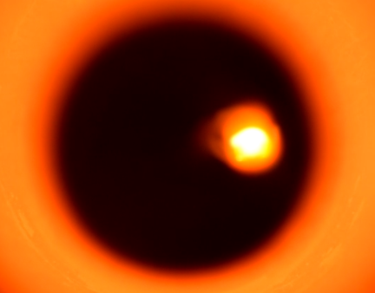
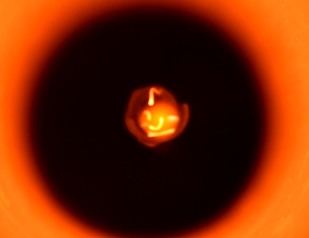
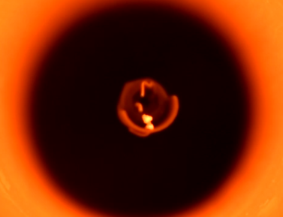
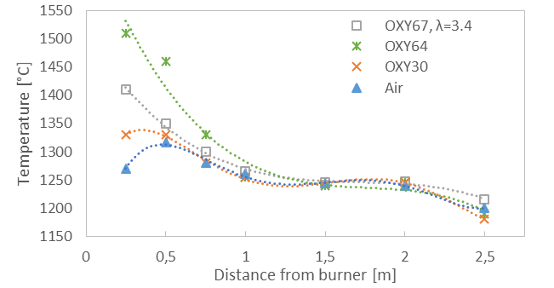
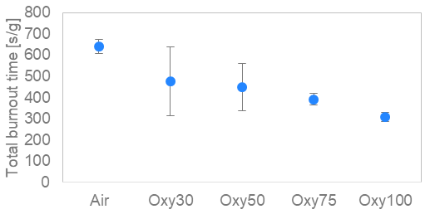
Highlights
Task 2.3
4 kW single particle burner: 8mm CARDBOARD
20 kW facility: 1.5 kg/h COAL
Ignition
Volatile flame
Burnout
Air
 |  | Unit | Air | OXY30 | OXY58 | OXY67
Primary Gas | Volume flow rate | Nm³/h | 4.14 | 0.6 CO₂ 1.1 O₂ | - | 2.2 CO₂ 5.2 O₂
 | Composition | - | Air | OXY | - | OXY
Secondary Gas | Volume flow rate | Nm³/h | 6.09 | 2.8 CO₂ 1.2 O₂ | 2.11 O₂ | 2.2 O₂
 | Composition | - | Air | OXY | O₂ | O₂
Carrier Gas | Volume flow rate | Nm³/h | 1.45 | 1.45 | 1.5 | 1.45
 | Composition | - | Air | CO₂ | CO₂ | CO₂
Air-fuel equivalence ratio λ |  | - | 1.05 | 1.05 | 1.05 | 3.4
Oxy30
Oxy50
Oxy75
Oxy100
OXY58

Slide 9
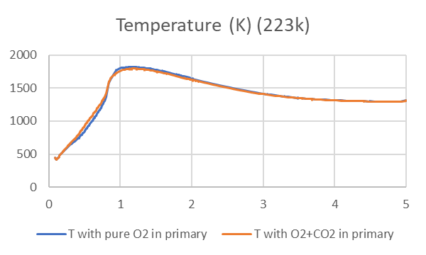
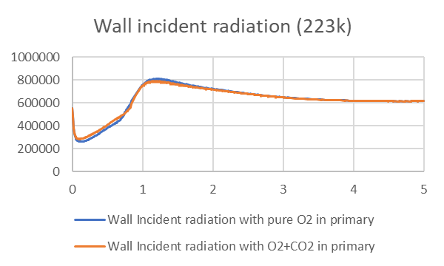
Highlights
Task 2.4
Test run of a case with no FGR with 1st gen oxy-burner to 100% O2
100% O2 in high velocity nozzles
100% CO2 in carrier and secondary
Same overall concentration as earlier
Results indicates good mixing
Preparation of full scale model setup
Wall temperature
Mole fraction of CO₂
Preparation of the clinker 1D model

Slide 10
Deviations from plan
WP 2 |  | USTUTT
2.1 | M2.1- SRF characterization tests started | USTUTT | M4 | ✓
 | M2.2- Commissioning of 1st generation oxyfuel burner and facility in Task 2.1 | USTUTT-TKIS | M7 | ✓
 | M2.3- Demonstration tests of 1st generation oxyfuel burner in Task 2.1 started | USTUTT | M8 | ✓
 | M2.4- Data transfer from Task 2.1 to Task 2.2 and WP4 started | USTUTT | M10 | ✓
 | D2.1- Report on pilot-scale demonstration tests of the 1st generation oxyfuel burner with selected oxygen enrichment using high share of alternative fuels | USTUTT | M18 | Ongoing M24
2.2 | M2.5- Data transfer from Task 2.2 to WP4 started | CERTH | M13 | Ongoing
 | D2.2- Report on CFD simulations of 1st generation oxyfuel burner using high shares of alternative fuels | CERTH | M19 | Ongoing M25
2.3 | M2.6- Commissioning of 2nd generation oxyfuel burner and facility in Task 2.3 | USTUTT-TKIS | M17 | Ongoing
 | M2.7- Demonstration tests of 2nd generation oxyfuel burner in Task 2.3 started | USTUTT | M19 | M30
 | M2.8- Data transfer from Task 2.3 to Task 2.4 and WP5 started | USTUTT | M22 | M33
 | D2.3- Report on pilot-scale demonstration tests of the 2nd generation prototype oxyfuel burner with the firing concept of up to 100 % oxygen | USTUTT | M30 | M36
2.4 | M2.9- Data transfer from Task 2.4 to WP5 started | SINTEF | M24 | Ongoing
 | D2.4- Report on CFD simulations of the 2nd generation oxyfuel kiln burner on pilot- and full-scale | SINTEF | M30 | Ongoing

Slide 11
Deviations from plan
Task 2.1 and 2.2
The experimental demonstrations in Task 2.1 were delayed due to pandemic regulations and restrictions.
Task 2.2 was directly affected by the delay. The following restrictions were faced due to COVID-19 in March and April 2020:
70-80 % work flexibility reduction
Shut-down and entry restrictions in labs and pilot-plants (USTUTT)
Cancelation of scheduled measurement campaigns
Restricted entry to the institute due to lack of mask availability in the market
Delay in delivery of safety equipment, fuel and spare parts (for maintenance on the facility which was planned in March and April).
In July 2020, 100 % alternative fuel (SRF) was fired and a steady 200 kW combustion was achieved. The alternative fuel dosing system and burner had to be optimized to accommodate the high percentage of SRF needed for the process
In November 2020, 100 % alternative fuel tests were performed, the bluff-body in the burner inlet needed to be optimized to help reduce the flame length
In February 2021, stable 100 % SRF combustion measurement campaign was a success
Task 2.3 and 2.4
Due to delays in the Task 2.1, the preparations for the 2nd generation burner tests will be delayed several months.
Combustion tests with 100 % oxygen were performed in March in the 20 kW facility at USTUTT.
It is anticipated that task 2.4 will face subsequent delays.

Slide 12
Expected impact - Status
AC²OCem results | Expected impact | Impact status
Demonstration at TRL 6 of the 1st generation oxyfuel technology firing large shares up to 100 % of alternative fuels with a prototype kiln burner | The use of large shares of alternative fuels with high biogenic content opens the possibility to promote Bio-CCS and consequently potentially negative CO2 emissions. Additionally, according to ECRA [7], one of the project phases of the envisaged oxyfuel demonstration tests includes the operation of a cement kiln on 100 % alternative fuels. Therefore, results of AC2OCem project will close the knowledge gap for future oxyfuel demonstration tests. | Accomplished stable combustion with 100% SRF. Part of the data has been disseminated as part of a presentation and paper publication in frame of the TCCS-11 conference (June 2021)
Demonstration at TRL 6 of the kiln burner of the 2nd generation oxyfuel technology applying up to 100 % oxygen enrichment in the burner and avoiding flue gas recirculation. | Greenfield projects can benefit from this innovative oxyfuel concept that is expected to positively impact the OPEX and CAPEX due to diminished gas volume to be transported, smaller aggregate dimensions and potentially higher energy efficiency. | Will be addressed in Q1-2022

Slide 13
Planned work
Task 2.1 Wood pellets & biomass combustion tests (500 kW burner) → planned in July 2021
Task 2.2 Optimize the simulation of SRF with air to match the experimental results in the near-burner area Simulate the SRF with oxyfuel combustion case (30% oxygen)
Task 2.3 Test OXY > 67 in the 20 kW burner incl. tests with wood pellets Tests with up to 100 % O₂ in the 500 kW burner → possibly with wood pellets
Task 2.4 Preparation of full scale model setup Preparation of the clinker 1D model: Clinker formation model in the kiln is being made and will be linked to the CFD sequentially

Slide 14
Cynthia Kroumian
Cynthia.Kroumian@ifk.uni-stuttgart.de
66211
63491

